Slide 1
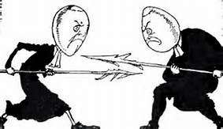
Number Storage
How Numbers are stored in the computer

Slide 2
Decimal Number Conversion
A decimal shown in Hexadecimal and Binary
Convert Decimal to Base n
DEC | HEX | BIN
0 | 0 | 0000
1 | 1 | 0001
2 | 2 | 0010
3 | 3 | 0011
4 | 4 | 0100
5 | 5 | 0101
6 | 6 | 0110
7 | 7 | 0111
8 | 8 | 1000
9 | 9 | 1001
10 | A | 1010
11 | B | 1011
12 | C | 1100
13 | D | 1101
14 | E | 1110
15 | F | 1111
 | Decimal: |  | 2,347
 | Hex: |  | 09 |  | 2B
 | Binary: |  | 0000 | 1001 | 0010 | 1011
 |  |  | 0 |  |  |  |  | 0 | 0 | 9 |  |  |  |  | 0 | 1 | 4 | 6
 | 1 | 6 | 9 |  |  | 1 | 6 | 1 | 4 | 6 |  |  | 1 | 6 | 2 | 3 | 4 | 7
 |  |  | 0 |  |  |  |  | 0 |  |  |  |  |  |  | 0
 |  |  | 9 |  |  |  |  | 1 | 4 |  |  |  |  |  | 2 | 3
 |  |  |  |  |  |  |  |  | 0 |  |  |  |  |  | 1 | 6
 |  |  |  |  |  |  |  | 1 | 4 | 6 |  |  |  |  |  | 7 | 4
 |  |  |  |  |  |  |  | 1 | 4 | 4 |  |  |  |  |  | 6 | 4
 |  |  |  |  |  |  |  |  |  | 2 |  |  |  |  |  | 1 | 0 | 7
 |  |  |  |  |  |  |  |  |  |  |  |  |  |  |  |  | 9 | 6
 |  |  |  |  |  |  |  |  |  |  |  |  |  |  |  |  | 1 | 1
 |  |  | 9 |  |  |  |  |  |  | 2 |  |  |  |  |  |  |  | B
Shortcut Method
Quotient | Base | Div | Mod | Digit
2347 | 16 | 146 | 11 | B
146 | 16 | 9 | 2 | 2
9 | 17 | 0 | 9 | 9
0 | 18 | 0 | 0 | 0

Slide 3
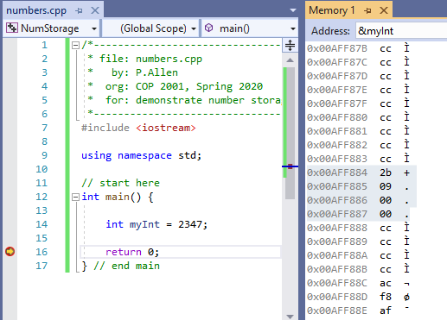
Storage of int
[myInt] shown in memory
2347 => 0x092B
[myInt] -> 0x00AFF884
0x00AFF884 => 2b
0x00AFF885 => 09
0x00AFF886 => 00
0x00AFF887 => 00
Note: Value stored from lowest to highest byte: 2B 09 00 00
What is this type storage called?
Hint: refer to the image on the title slide

Slide 4
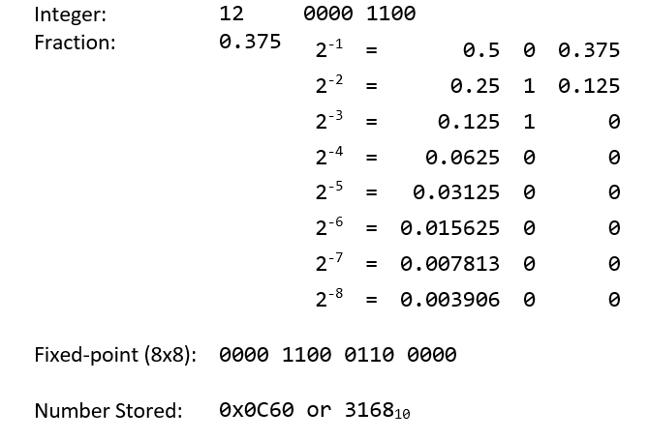
Fixed-Point Numbers
Convert integer to binary
12 => 0000 1100
Determine fraction bits that fit the remainder
0.375 => 0110 0000
Align (shift) integer binary
00001100.00000000
Add fraction bits
00001100.01100000

Slide 5
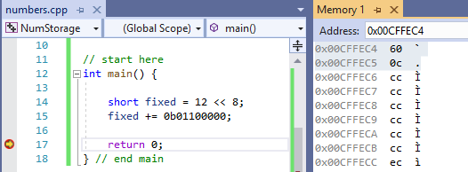
Fixed Point Numbers
Fixed-point (8x8) format
16-bit value
High byte => integer
Low byte => fraction
00000000.00000000
Example 12.375 =
0000 1100 . 0110 0000
0 C 6 0

Slide 6
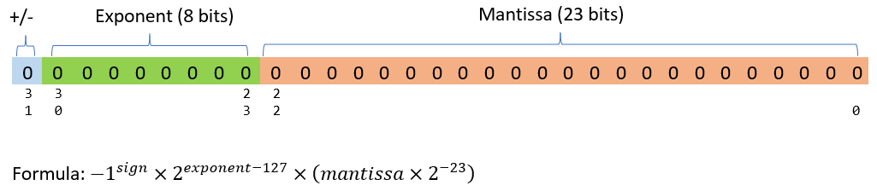
Floating-Point Numbers
IEEE 754 Single-Precision Floating-Point Binary Format
Number broken down into 3 parts
Sign
Exponent – (bias 127)
Mantissa

Slide 7
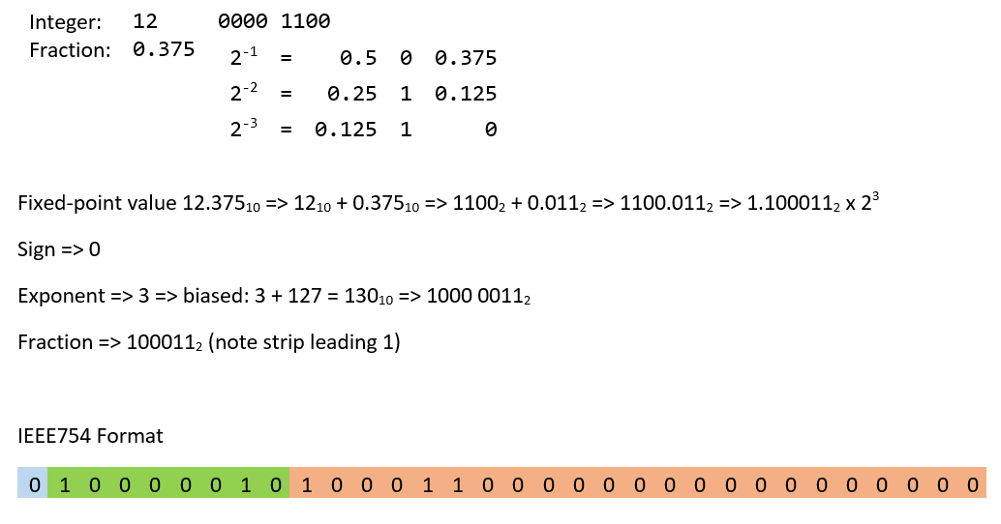

Floating-point Binary
Calculate Fixed-point number
Stop when fraction 0
This is the exponent
Add fraction binary to end of integer binary
Shift to first 1 digit
Store
Sign bit
Exponent + bias 127
Mantissa (fraction only)

Slide 8
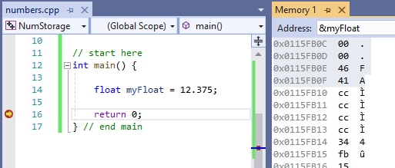
Floating Point Storage
[myFloat] shown in Memory
Value:

